Slide 1
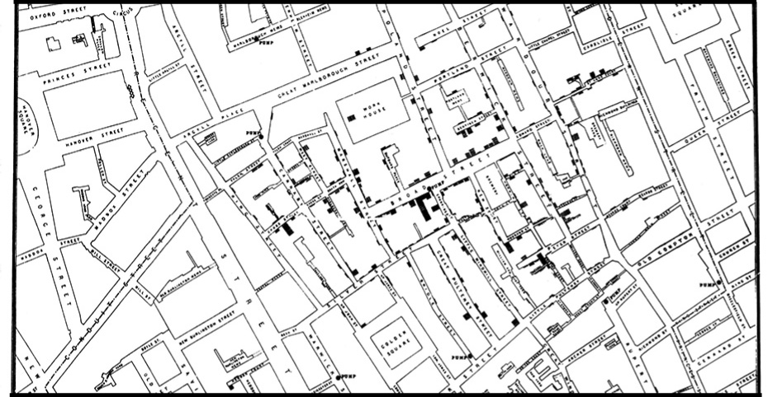
ONE OF THE FIRST DATA VISUALIZATIONS
Notes:
Slide 1: Choosing to record cholera deaths for each house on a map of the Soho neighborhood is one of the first and most famous data visualizations.

Slide 2
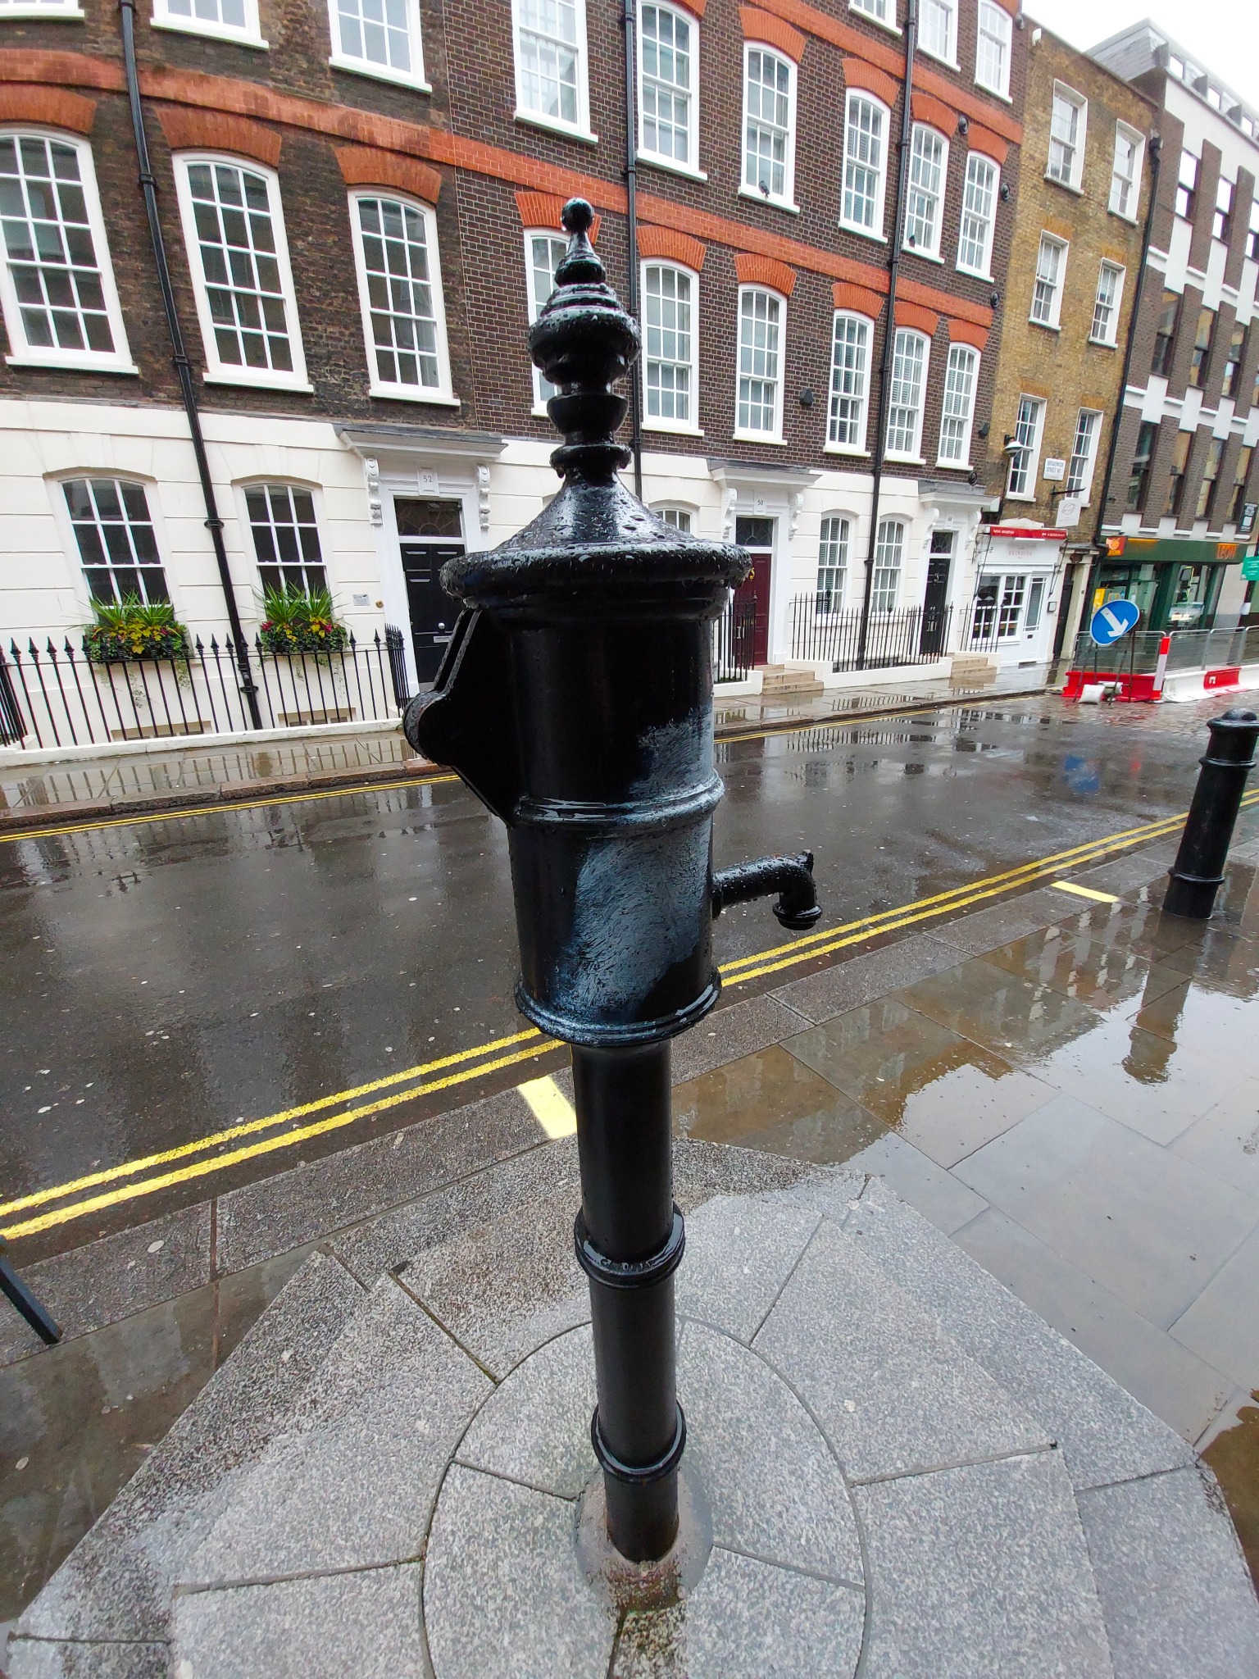
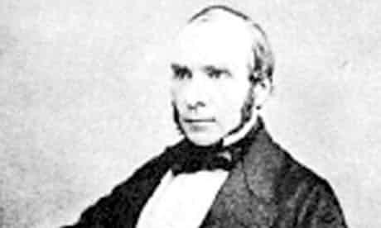
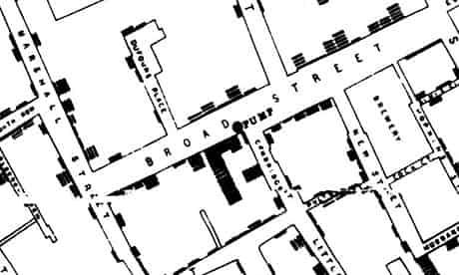
JOHN SNOW
The Father of Modern Epidemiology
Notes:
Slide 2: The creator of this map was John Snow and it clearly shows that the deaths centered around the Broad Street Pump. This is an excellent example of a visualization that very clearly communicates a message.

Slide 3
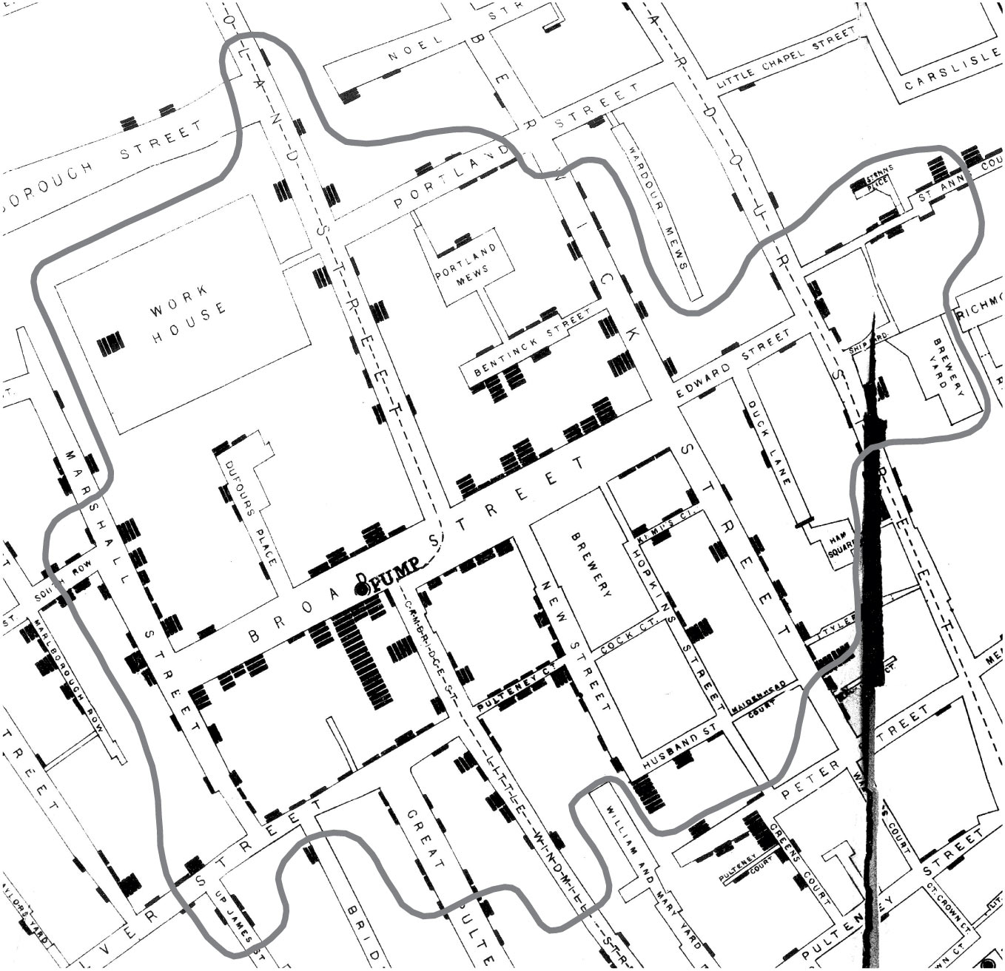
The Broad Street Pump
Snow is known for mapping the deaths which were centered around the Broad Street Pump.
But what do you think the outline he drew around the Broad Street Pump represents?
Notes:
Slide 3: However, in some versions of this map, John Snow drew a strangely shaped outline around the pump. What do you think he meant to show? Responses will likely point out that it circles most of the deaths. However, it does not include all of the deaths. Point out that it is not circular. As a hint, mention that there were several other pumps in the neighborhood.
Answer: The Broad Street Pump is the closest pump by walking distance for the houses within the outline. It is not a circle because people must walk by street to get to the pump.

Slide 4
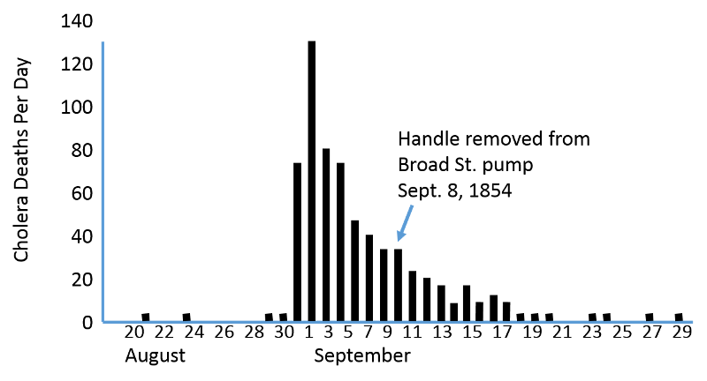
Considering time…
Using the patterns of the outbreak, Snow convinced authorities to remove the pump handle.
Did this end the outbreak?
Notes:
Slide 4: Explain that Snow’s data convinced city officials to stop usage of the Broad Street Pump by removing its handle on September 8, 1854. Ask, “Did this end the outbreak?”. It is natural for students to think, that yes it did because the outbreak effectively ended a week or two after the handle was removed, but the point of this graph is to consider our perspective of the outbreak from not just a spatial perspective, but a time (temporal) one as well.
This graph is known as an “epidemiology curve” and it shows the progression of the outbreak with deaths over time. From this data, it can be argued that the outbreak was already in decline even before the handle was removed. People were either leaving or avoiding the area of the outbreak even before the Broad Street pump was identified as the source. The news of many deaths in the area was enough data for people to naturally protect themselves through their behaviors. In other words, the outbreak would have likely ended even if the handle had not been removed.
Ask, does this suggest the waterborne theory was not correct? This is not a right/wrong question, but is meant to encourage students to see the need to consider other information, such as time, in testing and analyzing these theories.
To close out the lecture, explain that John Snow’s map did not suddenly convince everyone of the waterborne theory. As is the case in science, there are not “mic drop” moments. More data form more situations will need to be considered.

Slide 5
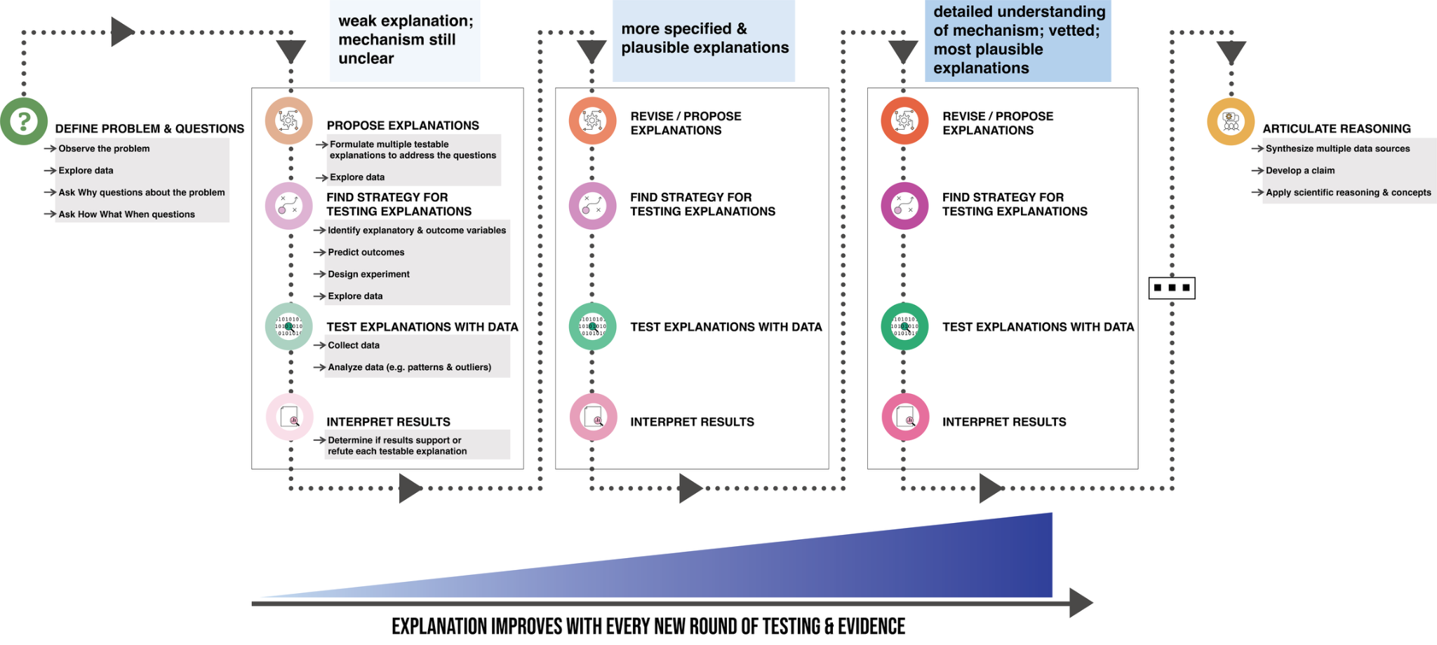
Moving toward developing a claim

